Slide 1
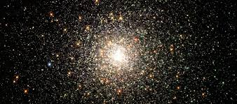

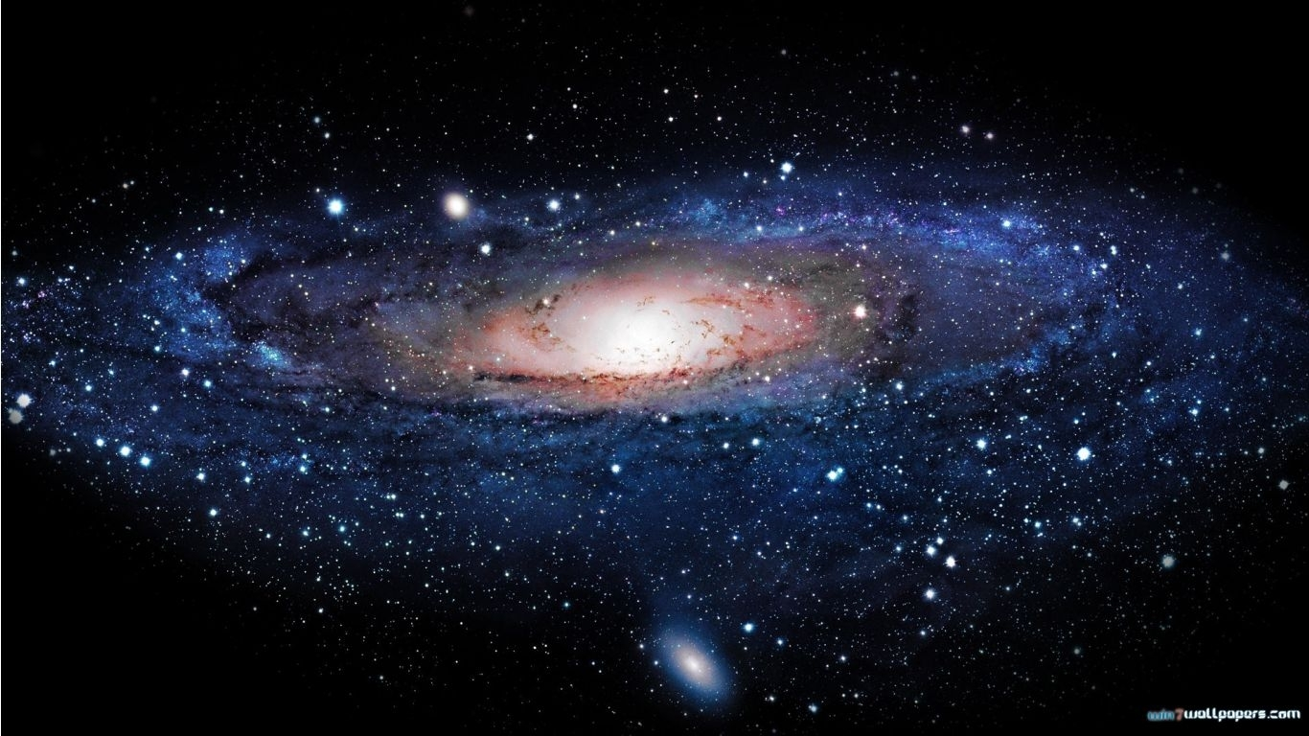
UHU Flag Option-1
Utilizing NASA Photo

Slide 2
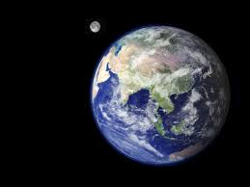
UHU Flag Option-2
Utilizing the NASA Photo

